Slide 1


Using Azure Serverless for business automation
Azure Serverless morning
Anders Eide Manager, KPMG @anderseide
Jan Egil Ring Lead Architect, Crayon @janegilring
Notes:
A | JE

Slide 2
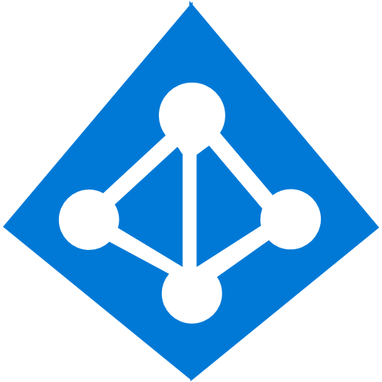
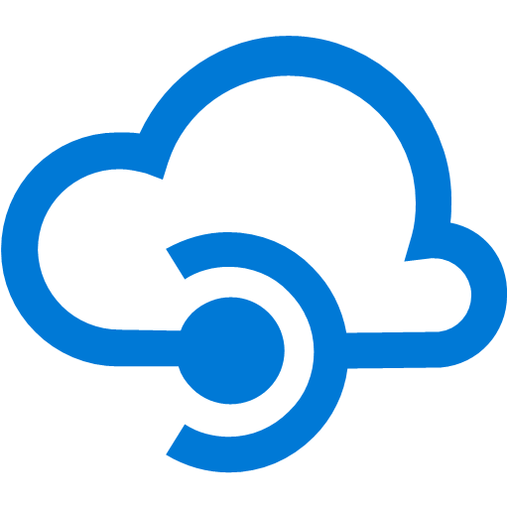
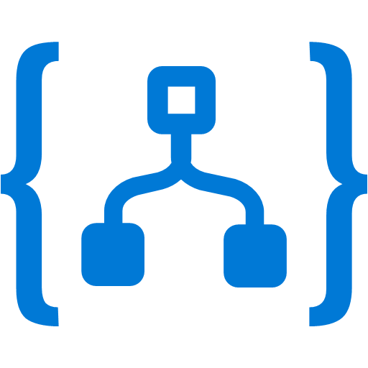


Agenda
Intro – sky- og serverløse tjenester
Demo
PowerApps
Logic Apps/Flow
Azure Functions
SharePoint Online
Azure AD
Oppsummering
Notes:
a

Slide 3


The “evolution” of application platforms
On-Premises
IaaS
PaaS
Serverless
@janegilring
@anderseide
Notes:
A

Slide 4
Before cloud
What is the right size of
servers for my business needs?
How do I deploy new code to my server?
What media should I
use to keep backup?
What happens in case of
server hardware failure?
Which packages should be on my server?
What size of servers
should I buy?
Who monitors
my App?
How often should I backup my server?
How can I scale my app?
How can I increase server utilization?
Who has physical
access to my servers?
Which OS should I use?
Do I need secondary network connection?
Are my server in a
secure location?
What happens if the
power goes out?
Who monitors
my Servers?
Do I need a UPS?
What storage I need to use?
How many servers
do I need?
How can I dynamically configure my app?
It takes how long to provision a new server?
How often should
I patch my servers?
@janegilring
@anderseide
Notes:
JE
Talking points: (New)
Note to speaker: no extra clicks needed, all visuals will fly in on their own at page load time.
Before Cloud (or even now), let’s say you run a successful business and you try to build business apps, you have two options. You can either build on premises or co-location. You will go and buy servers and infrastructure to run your business applications.
With that came many questions when you build and manage your own server. From what servers to buy, how to provision my new server, what do I do if there is hardware failure, to how to deploy my code and patch my servers, there are simply too many things to consider.
It can be overwhelming when you manage your own physical servers.

Slide 5
Then came IaaS—table stakes for digital business
What is the right size of servers for my business needs?
How can I increase server utilization?
How many servers do I need?
How can I scale my app?
How often should I patch my servers?
How do I deploy new code to my server?
How often should I backup my server?
Which OS should I use?
Which packages should be on my server?
Who monitors my App?
@janegilring
@anderseide
Notes:
A
points: (New)
Note to speaker: no extra clicks needed
Well, a much cleaner picture, isn’t it? A few years later, there is this thing called “IaaS”. The idea is, you don’t need to buy or build your own servers, use our infrastructure service, aka IaaS.
With that, you don’t have to worry about provisioning your servers, or securing the physical location of your server farm. Many questions go away.
But, there is but… you still need to think about which IOS to use, how to patch the server, in addition to managing your business apps. Can those tedious tasks be taken care of as well?

Slide 6
Then PaaS, critical for digital transformation
What is the right size of “servers” for my business needs?
How can I increase “server” utilization?
How many “servers” do I need?
How can I scale my app?
@janegilring
@anderseide
Notes:
JE
Talking points: (New)
Yes. We have this service called Platform as a Service, PaaS. What is great about it is, VM patching, IOS selection, back up and code deployment are all built into PaaS platform for you. Isn’t that great?
Now only four questions remain,
How many servers do I need?
What is the right size of server for my biz? S1, P3?
How can I increase server utilization?
More importantly, how I scale my app?
Let’s see how everything works together so far --- transition into the IaaS & PaaS chart.

Slide 7
Modernize your apps with PaaS
Value to business
Innovation
PaaS
Efficiency
IaaS
Time
@janegilring
@anderseide
Notes:
A

Slide 8
Serverless, the future platform for next gen apps
How do I architect my app to become Serverless?
@janegilring
@anderseide
Notes:
JE
Talking points: (New)
What do we go from here?
Introducing Serverless, an event-driven process, which will grow and scale on demand.
The only remaining question now becomes: How I architect my app to become Serverless? Pretty neat, right?
It all sounds great, naturally, you may ask, how does Serverless fit into the picture?

Slide 9
What is Serverless?
$
Abstraction of servers
Event-driven/ instant scale
Micro-billing
@janegilring
@anderseide
Notes:
A
Abstraction of servers, infrastructure and configuration of operating system
Event-driven scale
Sub-second billing
Stateless
Serverless compute is a fully managed service. Some refer to it as Functions as a Service
OS and Framework patching is performed for you
There is zero administrative tasks and no need to manage any infrastructure
You just deploy your code (function) and it runs
Your code runs within seconds and for very short period of time
Serverless compute scales quickly (almost instantly) and vastly
Automatically scales within seconds
No scale configuration is required (there is no way to configure scale or limits)
Scales to match any given workload. Scales from zero to handle tens of thousands concurrent functions invocations within seconds
Pay only for the time your code is running
Serverless compute reacts to events
React, in near real-time, to events and triggers
Triggered by virtually any event from Azure service or 3rd party services

Slide 10
Benefits of Serverless
Manage apps not servers
Reduced DevOps
Faster time to market
@janegilring
@anderseide
Notes:
A
“Pinnacle of PaaS compute”
Not just hardware “servers”, but software servers are also managed for you
Focus on business logic, not solving technical problems not core to business
Lower effort to get started makes it easier to experiment (bots, etc.)
Benefits of “Serverless”

Slide 11
Build apps faster with Serverless
Serverless
Value to business
Innovation
PaaS
Efficiency
IaaS
Time
@janegilring
@anderseide
Notes:
A
In today’s cloud enabled world, businesses are solving for maximum efficiency and faster time to market, while reducing IT spend.
Over the years we have seen businesses evolve from spinning VMs to leveraging the benefits of PaaS cloud such as managed infrastructure, scalability, high availability and cost.
Today, more businesses are trying to solve for what is core to their business focus – delivering services faster to their customers, while reducing IT spend significantly. The answer comes in the form of Serverless application platform.
In industry terms, when you hear someone say “Serverless” more often than not they are talking about Serveless Compute services which form the glue that enable developers to build their apps faster leveraging a variety of other PaaS services.
Serverless lets businesses maximize their benefits of the PaaS cloud by offering a fully managed infrastructure, with no servers to manage, provision and patch; hence reducing management overhead significantly. The event triggered programming model, allows for continuous auto-scaling and micro billing capabilities. Event-triggered compute and event-triggered scaling allows businesses to pay only for the compute power that was used, depending on the size of the workload.

Slide 12

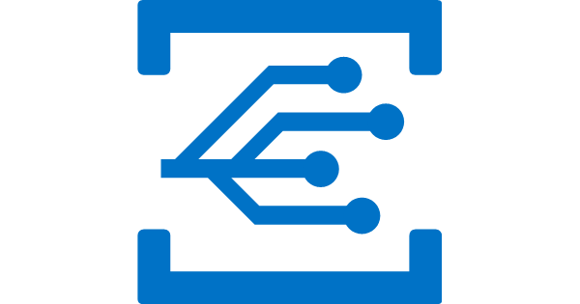


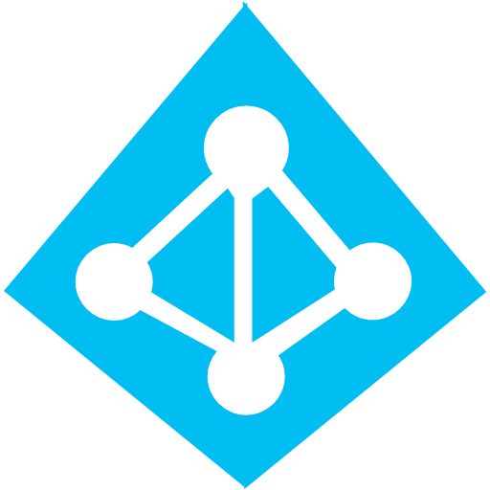
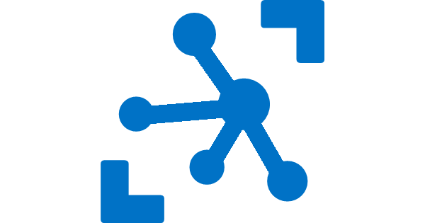

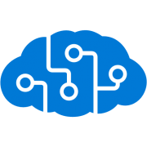
Serverless application platform components
Development
Platform
IDE support
Functions
Logic Apps
Event Grid
Developer productivity
Triggers and Bindings
Flexible deployment options
Visual designer
170+ connectors
Functions orchestration
Manage all events in one place
Near real-time delivery
Broad coverage
Integrated DevOps
Local development
Monitoring
Database
Storage
Security
IoT
Analytics
Intelligence
Visual Debug History
@janegilring
@anderseide
Notes:
JE
Lets talk about what really makes up MSFT’s Serverless platform: At the center of the Serverless platform, is our compute offerings: Azure Functions and Azure Logic Apps. Azure Functions is an event based Serverless compute experience that helps you accelerate your development. Logic Apps is a powerful orchestration tool. It enables building a Serverless app in minutes – by orchestrating multiple functions using a visual workflow tool.
Say you have your apps up and running using Serverless. Congratulations! You now need to collect intelligence from different apps across platforms to take actions upon. There are a few essential components which we think are core to building Serverless applications are:
Data/ Storage –Functions has triggers and bindings with Azure document DB and Azure Blob storage
** Triggers: Triggers are event responses used to trigger your custom code. They allow you to respond to events across the Azure platform or on premise.
** Bindings: Bindings represent the necessary meta data used to connect your code to the desired trigger or associated input or output data.
Messaging such as queues and topics using Azure Service Bus and Azure Event Hubs
Integration – that includes core LOB apps and SaaS apps integration via Azure Logic Apps.
Intelligence on data and sentiment/ predictive analysis using Cognitive services and Machine learning
Conversation as a service – how do we equip developers to build apps that offer an end-to-end experience for their end users – Azure Bot Service offers a Serverless interactive bot experience.
More, developers are spending more time writing code that allows them to add huge business impact with Serverless. MSFT offers numerous development tools such as IDE Support for Visual Studio in functions and Logic Apps, enables local development (vs web browser coding environment), visual debugging capability, all with your tools of choice.
Lastly, I also want to highlight top scenarios and use cases for Serverless:
Real-time Stream analytics: Customers can use Functions to feed real-time streams of data from application tracking into structured data and store it in SQL online.
SaaS event processing: Customers can use Functions and Logic Apps to analyze data from an excel file in Onedrive and perform validation, filtration, sorting and convert data into consumable business charts
Web app architecture: Used a lot in creating targeted marketing collaterals – when a customer clicks on a webpage, it triggers a webhook, that uses a function to create an ad that matches the customer profile and displays a completed webpage.
Real-time bot messaging: When customers send a message to a chatbox, Functions calls Cortana analytics to generate appropriate answers and sends a response back.
//from before: Customers have different paths to build a Serverless app – start by building the distributed application components using functions by leveraging the numerous templates and declarative bindings Or
Start with the workflow and orchestration of Serverless application using Azure Logic Apps. The visual designer enables developers to quickly and easily author, edit and visualize orchestration of multiple functions and workflow.

Slide 13
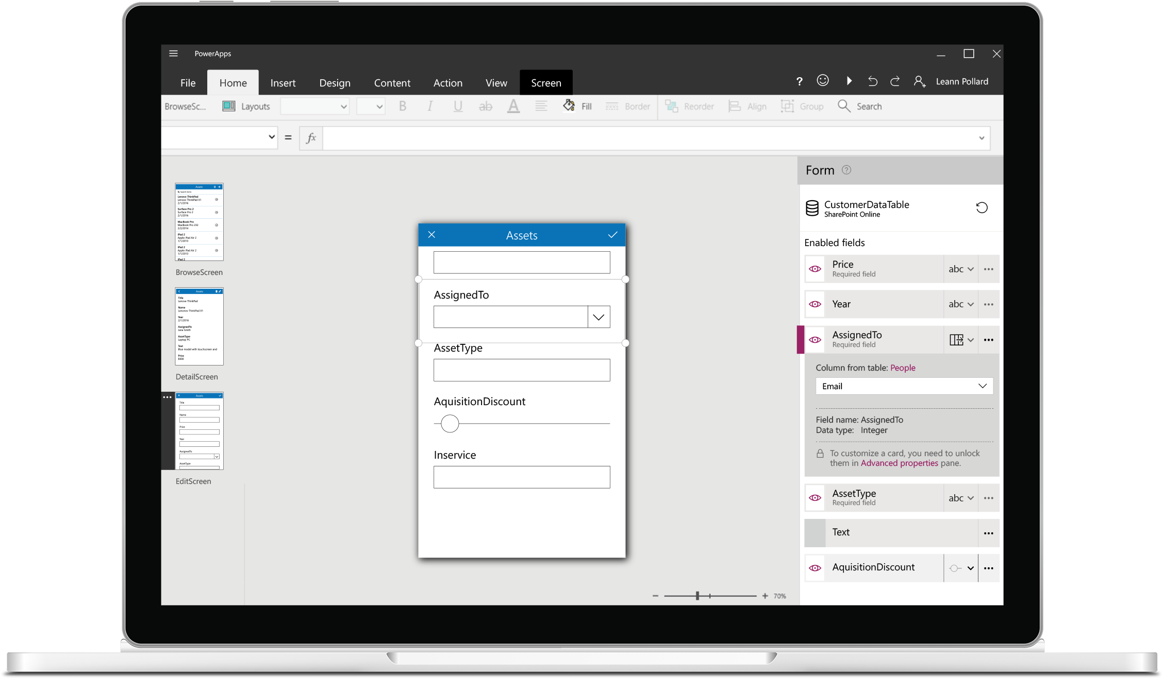
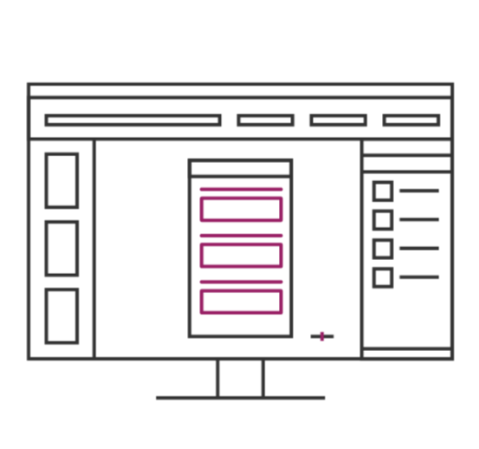
PowerApps
Build useful apps without writing code
Craft forms and screens in a visual designer that helps you see exactly what you’ll get
Build business logic into your apps with an Excel-inspired expression language
Take advantage of device capabilities like cameras, GPS, and pen controls
Extend the capabilities of connected data sources, or focus just on the bits you need
@janegilring
@anderseide
Notes:
A
Middle part first
Similar screens as in office, and feels like a mix of PowerPoint and Excel
Use device controls

Slide 14
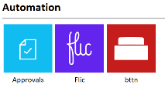
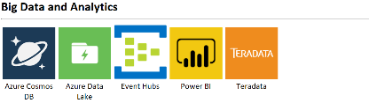
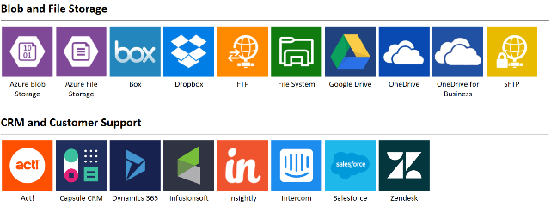
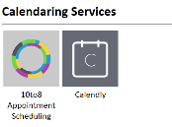
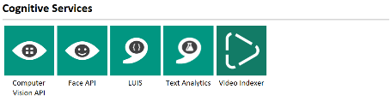
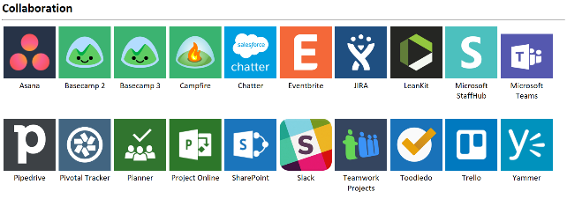
Connected data
Common data service provides a rich platform + standard model that gets creators instantly productive
Add 160+ connected data sources
Add custom connectors and on-premises sources
Notes:
JE

Slide 15
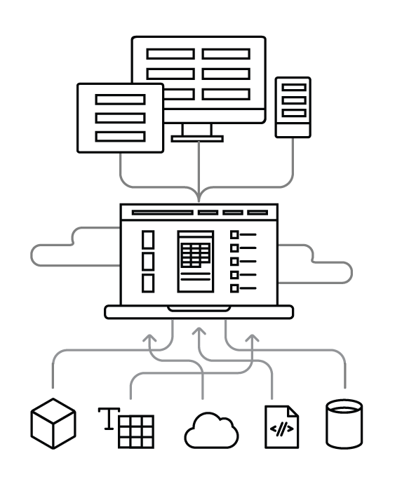
How it works
Use on web and mobile Find and use apps instantly on the web and in PowerApps mobile for iOS and Android
PowerApps Cloud Publish apps to people in your organization so they can access anywhere
Create in PowerApps Studio Build apps in a visual experience that shows exactly what you’ll get
Connections Build apps that interact with your data sources and respect their permissions
Your data PowerApps connects to a range of data sources and systems, including custom APIs
@janegilring
@anderseide
Notes:
A

Slide 16
Scenarios
Anything that needs to respond to events
Real-time stream processing
Timer-based processing
Millions of devices feed into Stream Analytics
Transform to structured data
Store data in Cosmos DB
Every 15 minutes
Find and clean invalid data
Clean table
Mobile app backends
Real-time bot messaging
?
...
Photo taken and WebHook called
Stores in blob storage
Produces scaled images
Message sent to Chatbot
Chatbot sends
response
Cortana Analytics answers questions
@janegilring
@anderseide
Notes:
JE
So what kind of apps and scenarios can be built using serverless technologies?
The answer is anything where there is need to run some logic in response to an event.
Some of you might be surprised to learn that, the above definition covers a big portion of the computing universe. Modern computing is all about events:
An IoT device sending data to analyze and store in real-time is an event. There are billions of those. Handling of such data such as enriching, analyzing or filtering is best done using serverless functions which can be spun up on demand.
Almost every web based application needs to run some regular maintenance task like cleaning up a database or synchronizing data between two systems. All of these times are events. Such tasks that need to be run only at specific times, don’t call for dedicated infrastructure. They are best left to serverless solutions.
A mobile app clicking a picture and submitting to backend is an event. There are billions of such apps. In many cases developers building such apps want to focus on delighting their customers using clients app experience. Serverless technology can easily take away the burden of building mobile backends.
Automated response systems receiving a customer request is an event. Building intelligent bots for such scenarios using serverless technology is again a great example where the focus needs to be on logic instead of infrastructure.
These are only some of the many examples which fit well with serverless.

Slide 17


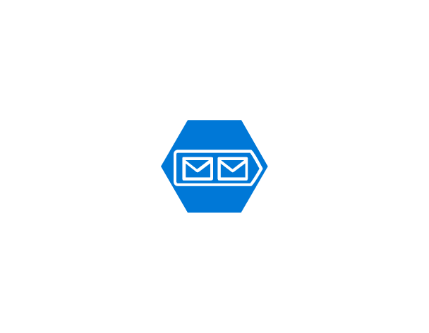
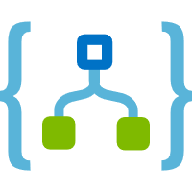
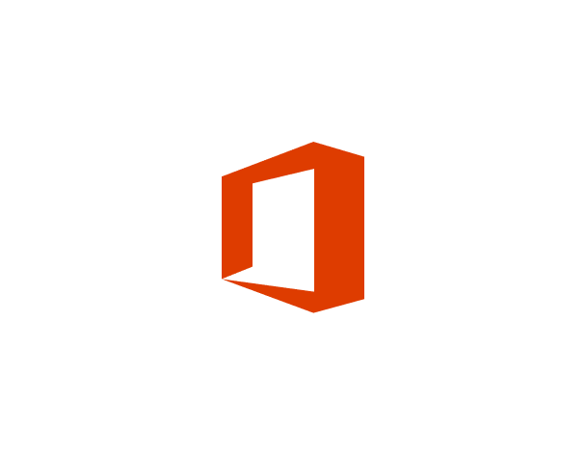
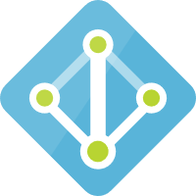
A hands on example – Order a Team
@janegilring
@anderseide
Notes:
A

Slide 18

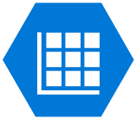

Flow steps – Order a Team
Flow Button
Approval
Storage Table
Storage Queue
Notification
@janegilring
@anderseide
Notes:
A

Slide 19
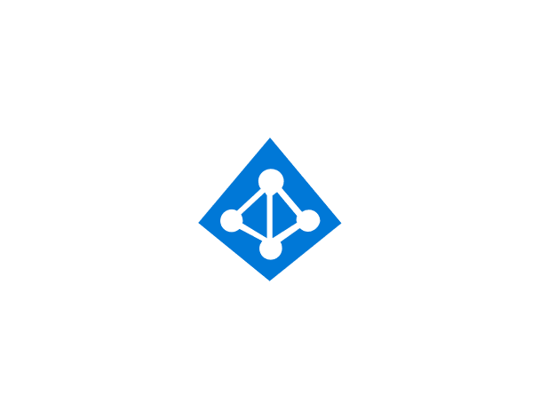

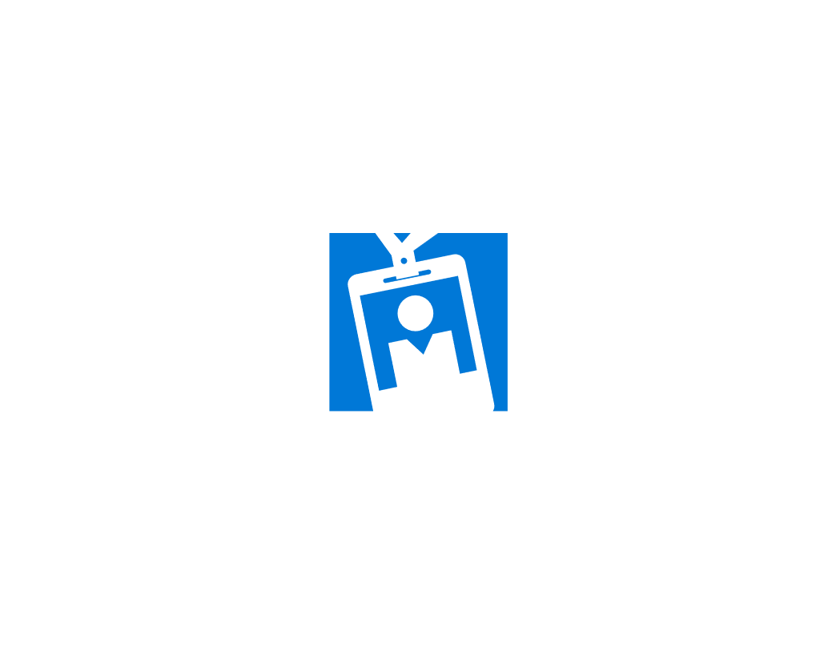
LogicApp steps – Order a Team
Storage Queue
Office 365
LogicApp
Parse Json
Storage Table
Azure AD
MS Graph
@janegilring
@anderseide
Notes:
A

Slide 20
Live demo
Notes:
A

Slide 21
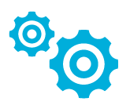
Automation & Configuration
Key Features
Manage any cloud & on premises
Windows & Linux
Configuration Management
Process Automation
Update Management
Azure
Any Cloud
Automation & Config
Configuration Management
DSC Configurations, Pull service
Node Management & Reporting
Change tracking & Inventory
Process Automation
Author runbooks - PowerShell, scripts PowerShell workflow, Graphical, Python2
Hybrid Runbook Workers with Proxy support
Update Management
Insights across your hybrid environment
Orchestrated updates and troubleshooting
Shared capabilities across features
Role Based Access Control
Secure, global store for variables, credentials, certificates, connections
Schedules
Modules
Source control support
Auditing
Tags
Hybrid Worker
On-Premises
Hyper-V
VMWare
OpenStack
Reliable, highly available, scalable
Hybrid management Integrate existing systems
Notes:
JE

Slide 22
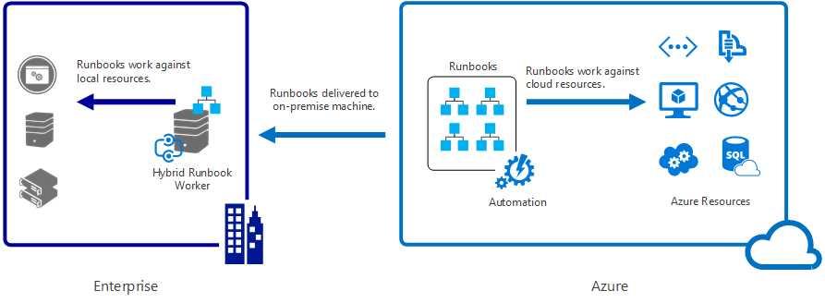
Hybrid Workers
cd "C:\Program Files\Microsoft Monitoring Agent\Agent\AzureAutomation\<version>\HybridRegistration"
Import-Module HybridRegistration.psd1
Add-HybridRunbookWorker –Name <String> -EndPoint <Url> -Token <String>
Notes:
JE
No VPN
The Hybrid Worker Agent is continuously listening for new job requests

Slide 23
Hands-on example #2: Automated user on/offboarding
Frontend: PowerApps
Data store: Sharepoint list
Trigger/workflow engine: Azure Logic Apps
Automation engine: Azure Automation & PowerShell
Notes:
JE

Slide 24
Flow chart Automated user on/offboarding
Notes:
JE

Slide 25
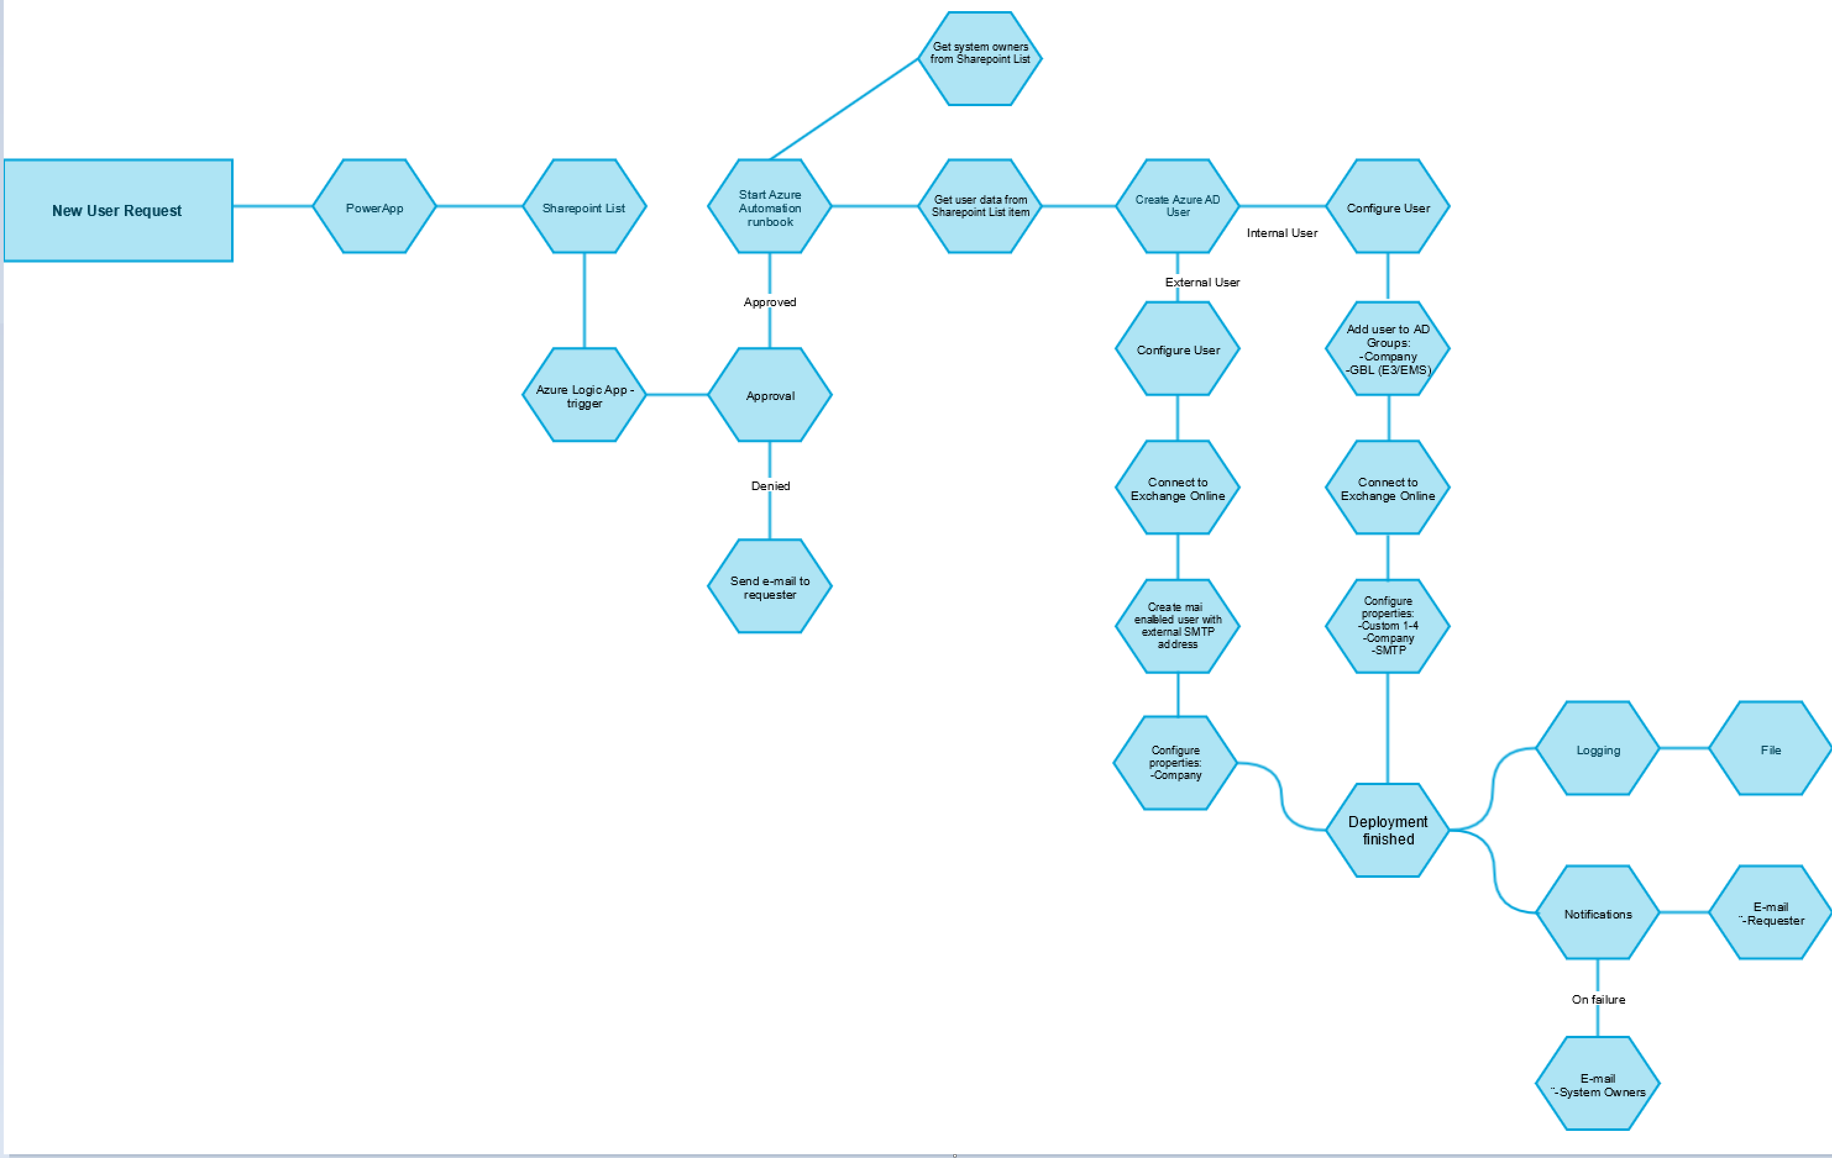
Notes:
JE
Bruker starter «New Employee» Logic App via mobil eller PC
Nytt element legges inn i en Sharepoint-liste med all nødvendig info om ny bruker
En Logic App sjekker denne lista etter nye elementer hvert 3. minutt
Når Logic App starter vil det gå en Approval melding til definert person
Blir godkjennings-forespørsel akseptert vil en Azure Automation runbook trigges
Runbooken leser info fra Sharepoint-lista og oppretter ny bruker

Slide 26
Serverless application platform components
Development
Platform
IDE support
Functions
Logic Apps
Event Grid
Developer productivity
Triggers and Bindings
Flexible deployment options
Visual designer
170+ connectors
Functions orchestration
Manage all events in one place
Near real-time delivery
Broad coverage
Integrated DevOps
Local development
Monitoring
Database
Storage
Security
IoT
Analytics
Intelligence
Visual Debug History
@janegilring
@anderseide
Notes:
A/JE
Lets talk about what really makes up MSFT’s Serverless platform: At the center of the Serverless platform, is our compute offerings: Azure Functions and Azure Logic Apps. Azure Functions is an event based Serverless compute experience that helps you accelerate your development. Logic Apps is a powerful orchestration tool. It enables building a Serverless app in minutes – by orchestrating multiple functions using a visual workflow tool.
Say you have your apps up and running using Serverless. Congratulations! You now need to collect intelligence from different apps across platforms to take actions upon. There are a few essential components which we think are core to building Serverless applications are:
Data/ Storage –Functions has triggers and bindings with Azure document DB and Azure Blob storage
** Triggers: Triggers are event responses used to trigger your custom code. They allow you to respond to events across the Azure platform or on premise.
** Bindings: Bindings represent the necessary meta data used to connect your code to the desired trigger or associated input or output data.
Messaging such as queues and topics using Azure Service Bus and Azure Event Hubs
Integration – that includes core LOB apps and SaaS apps integration via Azure Logic Apps.
Intelligence on data and sentiment/ predictive analysis using Cognitive services and Machine learning
Conversation as a service – how do we equip developers to build apps that offer an end-to-end experience for their end users – Azure Bot Service offers a Serverless interactive bot experience.
More, developers are spending more time writing code that allows them to add huge business impact with Serverless. MSFT offers numerous development tools such as IDE Support for Visual Studio in functions and Logic Apps, enables local development (vs web browser coding environment), visual debugging capability, all with your tools of choice.
Lastly, I also want to highlight top scenarios and use cases for Serverless:
Real-time Stream analytics: Customers can use Functions to feed real-time streams of data from application tracking into structured data and store it in SQL online.
SaaS event processing: Customers can use Functions and Logic Apps to analyze data from an excel file in Onedrive and perform validation, filtration, sorting and convert data into consumable business charts
Web app architecture: Used a lot in creating targeted marketing collaterals – when a customer clicks on a webpage, it triggers a webhook, that uses a function to create an ad that matches the customer profile and displays a completed webpage.
Real-time bot messaging: When customers send a message to a chatbox, Functions calls Cortana analytics to generate appropriate answers and sends a response back.
//from before: Customers have different paths to build a Serverless app – start by building the distributed application components using functions by leveraging the numerous templates and declarative bindings Or
Start with the workflow and orchestration of Serverless application using Azure Logic Apps. The visual designer enables developers to quickly and easily author, edit and visualize orchestration of multiple functions and workflow.

Slide 27
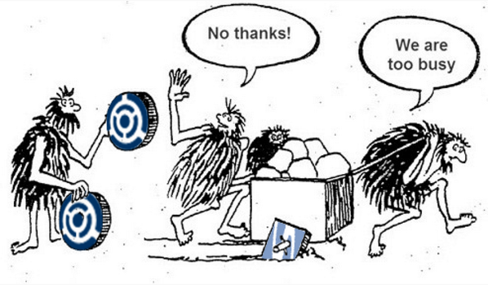
Key takeaways

Slide 28
Using Azure Serverless for business automation
Thank you all!
Azure Serverless morning
Anders Eide Manager, KPMG @anderseide
Jan Egil Ring Lead Architect, Crayon @janegilring

Slide 29
Backup content

Slide 30
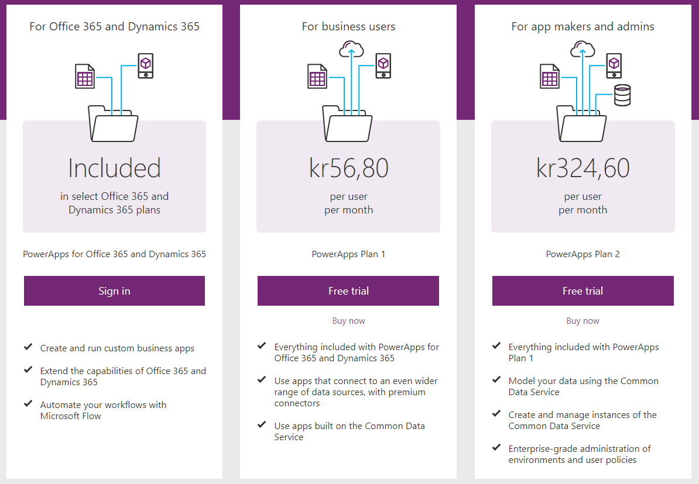
Pricing
Notes:
https://powerapps.microsoft.com/nb-no/pricing/
Common Data Service
Data storage in the Common Data Service (per user) Use premium connectors like Salesforce, DB2

Slide 31
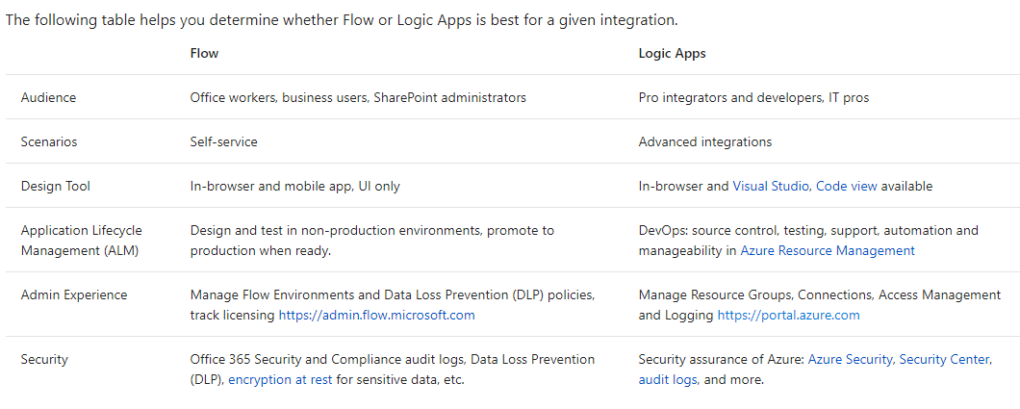
Microsoft Flow vs Logic Apps
Notes:
https://docs.microsoft.com/en-us/azure/azure-functions/functions-compare-logic-apps-ms-flow-webjobs
Flow: Runbooks will start in the context of the end user
Logic Apps: Runbooks will start in the context of the specified sevice connection

Slide 32
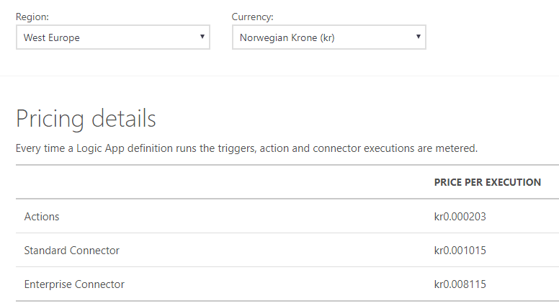
Pricing

